Slide 1
“Gang of Four” Design Patterns

Slide 2
Applying GoF design pattern
The common s/w problems and their solutions to these problems can be represented in a formal manner.
This representation is given by a design pattern.
A famous book “ Design patterns : Elements of Reusable Object Oriented s/w” is written by Erich Gamma, Richard Helm, Ralph Johnson and Ralph Vlissides .
These four peoples were nick named as Gang of Four(GoF).
This book discusses 23 design pattern.

Slide 3
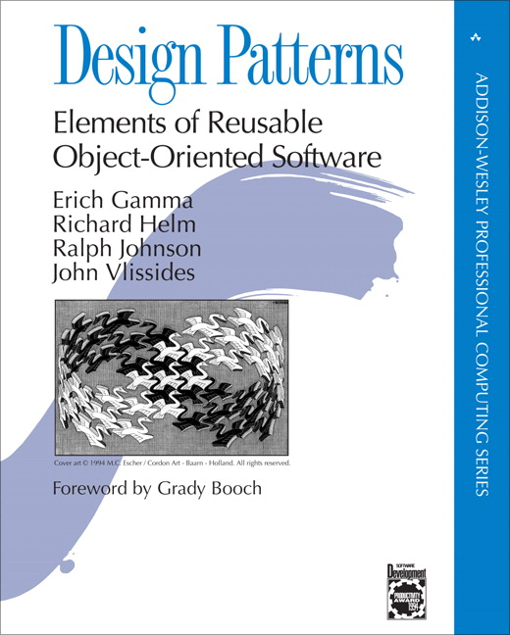
1995

Slide 4
The “gang of four” (GoF)
  Design Patterns book catalogs 23 different patterns
  Solutions to different classes of problems, in C++ & Smalltalk
  Problems and solutions are broadly applicable, used by many people over many years
  Patterns suggest opportunities for reuse in analysis, design and programming
  GOF presents each pattern in a structured format

Slide 5
Elements of Design Patterns
Design patterns have 4 essential elements:
  Pattern name: increases vocabulary of designers
  Problem: intent, context, when to apply
  Solution: UML-like structure, abstract code
  Consequences: results and tradeoffs

Slide 6
Design Patterns are NOT
If they are not familiar data structures or complex domain-specific subsystems, what are they?
They are:
  “Descriptions of communicating objects and classes
  that are customized to solve a general design problem in a particular context.”

Slide 7
Three Types of GoF Patterns
Creational patterns:
  Deal with initializing and configuring objects
Structural patterns:
  Composition of classes or objects
  Decouple interface and implementation of classes
Behavioral patterns:
  Deal with dynamic interactions among societies of objects
  How they distribute responsibility

Slide 8
Structural patterns
Assemble objects to realize new functionality
  Exploit flexibility of object composition at run-time
Example: Proxy
  Proxy acts as convenient surrogate or placeholder
  for another object.
  Examples
    Remote Proxy: local representative for object in a different address space.
    Virtual Proxy: represent large object that should be loaded on demand.
    Protected Proxy: protect access to the original object.

Slide 9
Structural Patterns
Adapter:
  Converts interface of a class into one that clients expect
Bridge:
  Links abstraction with many possible implementations
Composite:
  Represents part-whole hierarchies as tree structures
Decorator:
  Attach additional responsibilities to object dynamically
Facade:
  Simplifies the interface for a subsystem
Flyweight:
  Shares many fine-grained objects efficiently
Proxy:
  Provides a surrogate or placeholder for another object to control access to it

Slide 10
Adapter pattern
Problem: How to resolve incompatible interfaces or provide a stable interface to similar components with different interfaces?
Solution: Convert original interface component into another one through an intermediate adapter.
This pattern is also known as wrapper. This is GoF pattern.
2 types of adapters
1. object adapter
2. class adapter

Slide 11
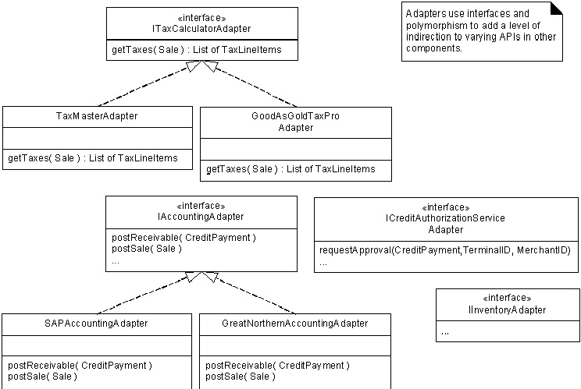
POS example: Instantiate adapters for external services

Slide 12
Benefits of Adapter pattern
Reduces coupling to implementation specific details
Polymorphism and Indirection reveals essential behavior provided
Including name of design pattern in new class (e.g., TaxMasterAdapter) in class diagrams and code communicates to other developers in terms of known design patterns

Slide 13
Creational Patterns
Singleton: Guarantee access to a singular (sole) instance
Simple Factory: Create specialized, complex objects
Abstract Factory: Create a family of specialized factories
Factory Method: Define an interface for creating an object, but let subclasses decide which class to instantiate
Builder: Construct a complex object step by step
Prototype: Clone new instances from a prototype
Lazy initialization: Delay costly creation until it is needed

Slide 14

Singleton pattern (creational)
A class with just instance and provide a global point of access
  Global Variables can be dangerous!
  (side effects, break information hiding)
class Singleton
{ public:
static Singleton* getInstance();
protected: //Why are the following protected?
Singleton();
Singleton(const Singleton&);
Singleton& operator= (const Singleton&);
private: static Singleton* instance;
};
Singleton *p2 = p1->getInstance();

Slide 15
Simple Factory pattern
Context/Problem
  Who should be responsible for creating objects when there are special considerations, such as complex logic,a desire to separate the creation responsibilities for better cohesion, and so forth
Solution
  Create a Pure Fabrication to handle the creation

Slide 16
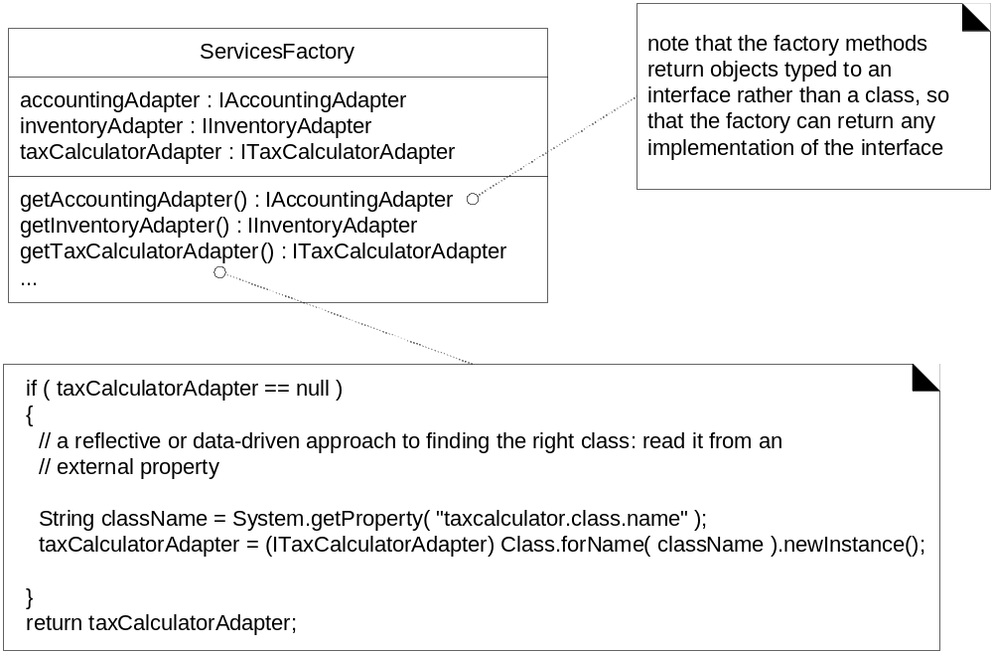
Factory can create different objects from a file
Figure 26.5

Slide 17
Advantages of Factory Objects?
Separates responsibility of complex creation into cohesive helper classes
Hides complex creation logic, such as initialization from a file
Handles memory management strategies,
such or recycling or caching

Slide 18
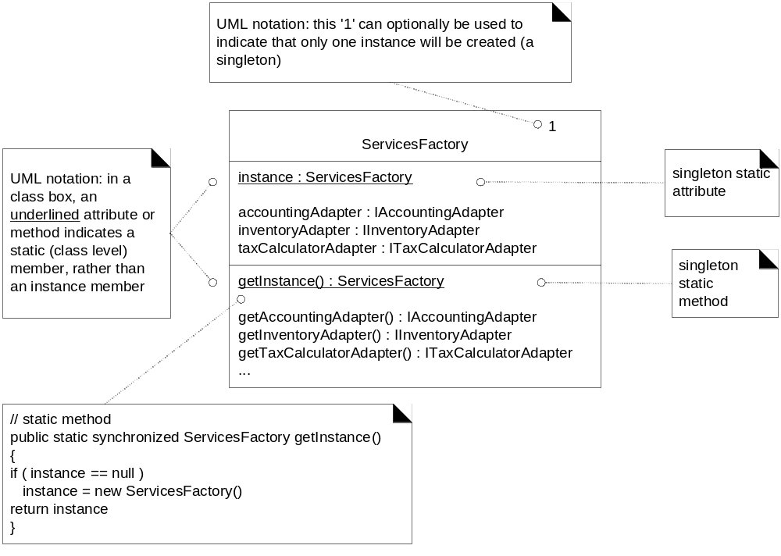
Use Singleton to create a Factory
Figure 26.6

Slide 19
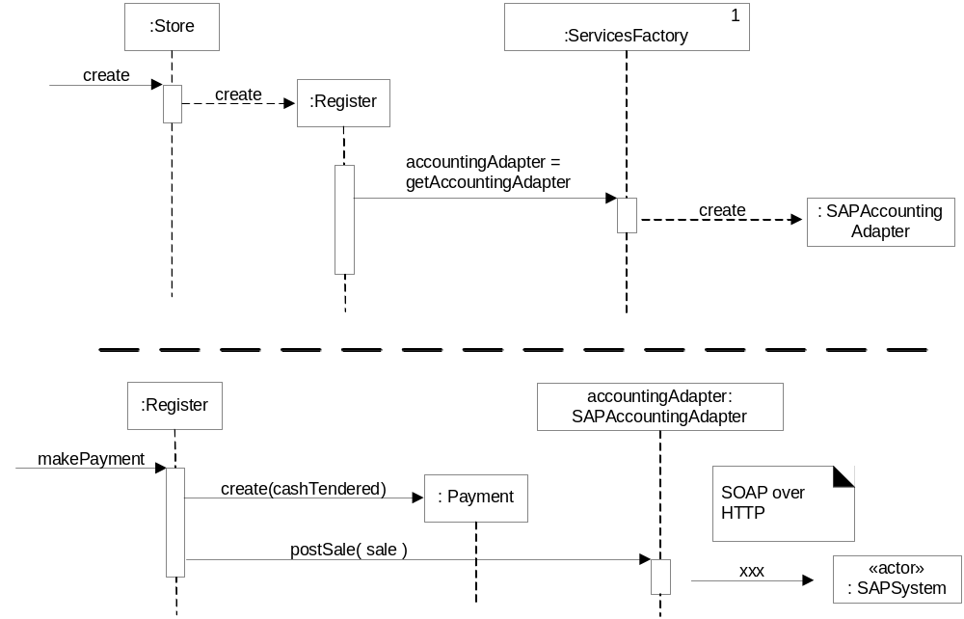
Adapter, Factory and Singleton working together
Figure 26.8

Slide 20
Behavioral Patterns
Chain of Responsibility:
  Request delegated to the responsible service provider
Command:
  Request or Action is first-class object, hence storable
Iterator:
  Aggregate and access elements sequentially
Interpreter:
  Language interpreter for a small grammar
Mediator:
  Coordinates interactions between its associates
Memento:
  Snapshot captures and restores object states privately
Which ones do you think you have seen somewhere?

Slide 21
Behavioral Patterns (cont.)
Observer:
  Observers update automatically when observed object changes
State:
  Object whose behavior depends on its state
Strategy:
  Abstraction for selecting one of many algorithms
Template Method:
  Algorithm with some steps supplied by derived class
Visitor:
  Operations applied to elements of a heterogeneous object structure

Slide 22
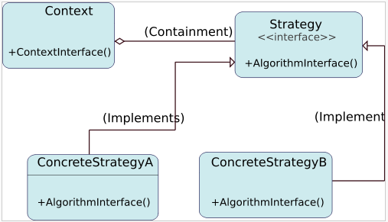
Strategy design pattern
Problem: How to design a family of algorithms or policies that are essentially the same but vary in details?
Solution: "Define a family of algorithms, encapsulate each one, and make them interchangeable." [Gamma, p315]
Use abstraction and polymorphism to show high level algorithm and hide varying implementation details

Slide 23
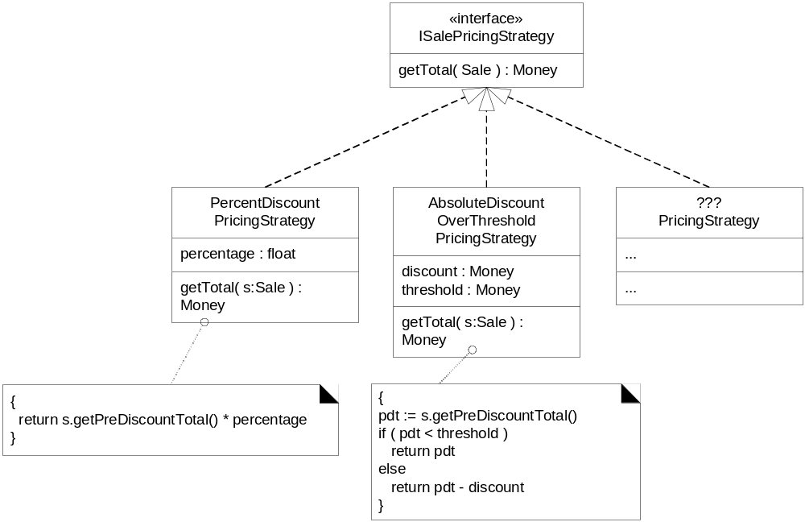
Multiple SalePricingStrategy classes with polymorphic getTotal method
Figure 26.9

Slide 24
Observer pattern
Intent:
  Define a one-to-many dependency between objects
  so that when one object changes state, all its dependents are notified and updated automatically
Used in Model-View-Controller framework
  Model is problem domain
  View is windowing system
  Controller is mouse/keyboard control
How can Observer pattern be used in other applications?
JDK’s Abstract Window Toolkit (listeners)
Java’s Thread monitors, notify(), etc.

Slide 25
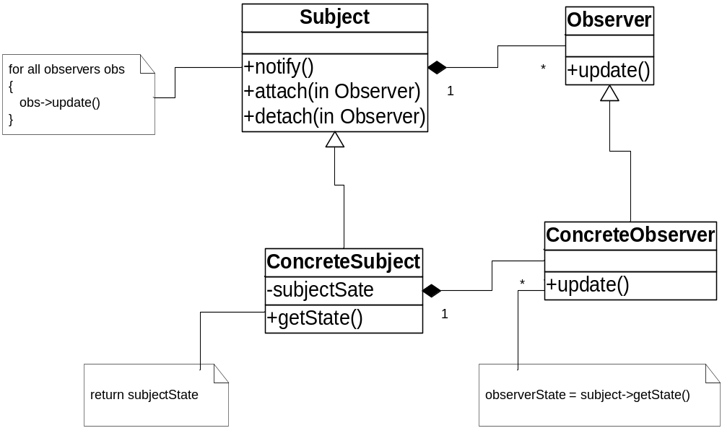
Structure of Observer Pattern

Slide 26
Benefits of Design Patterns
Design patterns enable large-scale reuse of software architectures and also help document systems
Patterns explicitly capture expert knowledge and design tradeoffs and make it more widely available
Patterns help improve developer communication
Pattern names form a common vocabulary

